Slide 1
The Donaldson Report
Our Experiences … so far …

Slide 2
The need for curriculum reform in Wales
The world is changing extremely fast and expectations of schools are incoherent and contested but continue to grow
There’s a need to establish an agreed strategic vision and sense of purpose
Curriculum structure, pedagogy and assessment should reflect this vision

Slide 3
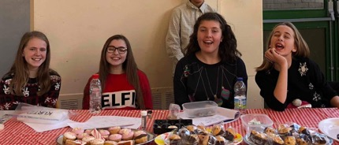
The need for curriculum reform OECD
“..many of today’s schools have not caught up as they continue to operate as they did in the earlier decades of the 20th Century.”
“How can learning within and outside schools be reconfigured to address the deeper knowledge and skills so crucial in our new century?”
“To succeed in this is not only important for a successful economy, but also for effective cultural and social participation and for citizens to live fulfilling lives.”
Education should reflect society … but think about what you would want for your own children
Notes:
Examinations!

Slide 4
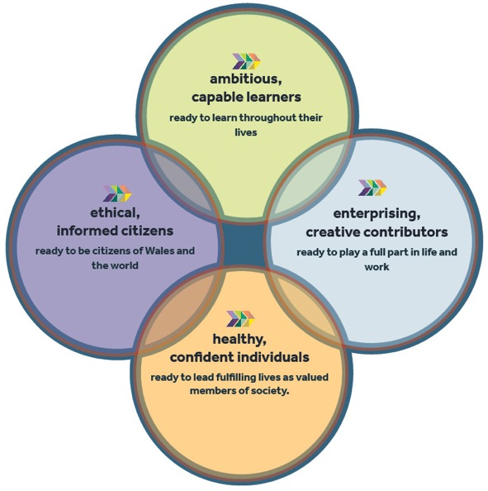
Embedded within the curriculum
4 Key Purposes
Notes:
The 4 key principles underpin everything that we do. This is what we are trying to create for our new society in the 21st century. This is the fundamental driver of everything we do.

Slide 5
Embedded within the curriculum
4 Key Purposes
The four purposes are at the heart of the new curriculum and are the starting point for all decisions on the content and experiences developed.

Slide 6
Learning and Experience
Six Areas of Learning and Experience
Three Cross Curriculum Responsibilities
Notes:
The 6 areas of learning and experience are expressive arts, language, literacy and communication, mathematics and numeracy, science and technology, Humanities, health and wellbeing.

Slide 7
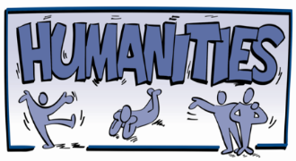
Seen as a subject unto itself
The 4 Key purposes underpinned the content selected
Then the historical and geographical skills could be tailored to the content.
A Start
Notes:
Wanted to avoid just combining history and geography together and teaching them as separate entities (as I think there was a real danger of doing). We wanted to see humanities as a subject in its own right. Now that’s difficult! Especially with very established members of staff. The 4 key purposes underpinned everything when selecting appropriate content and we wanted to select current affairs as a starting point to what we were trying to achieve. The skills and principles of Geography and History could then be tailored to each lesson (not as just an add on but to enrich the learning experience of each lesson). Some lessons were inherently more Geography and some were inherently more History … some as we have found require a foundation of religious knowledge.

Slide 8
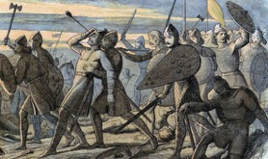
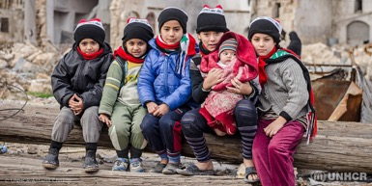
Identity
Diversity
Migration / Invasion
Was supposed to link into battle of Hastings … but ...
It evolved as a subject following a lesson on the Syrian refugee crisis and forced migration
The pupils naturally became creative and curious and took the lead … they were obsessed!
We needed to be confident enough as teachers to adapt
Historical and geographical skills naturally fitted nicely to enrich the learning.
Our First Topic …

Slide 9
Assessment – a second hurdle
How do we assess progress? Attainment?
New curriculum = new assessment measures
Again, pupils were given ownership … we wanted them to excel in a way that they are able to excel
Along with stringent measures of Gold, Silver and Bronze linked with the Literacy Numeracy Framework and the Digital Competency Framework.
Pupils completed a speech (literacy success criteria) and raised awareness in their own way (creativity)
Notes:
This is a difficult area.

Slide 10
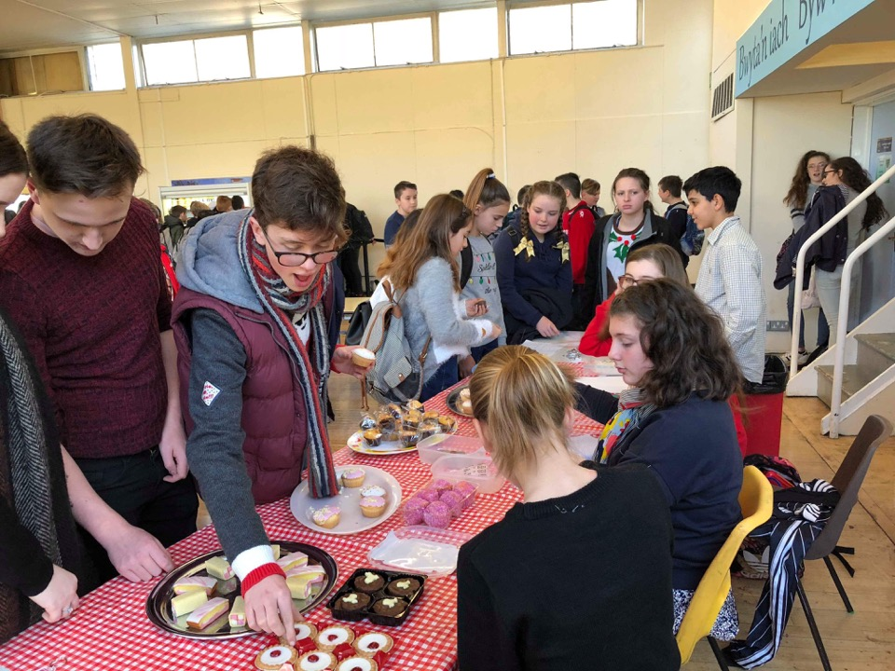
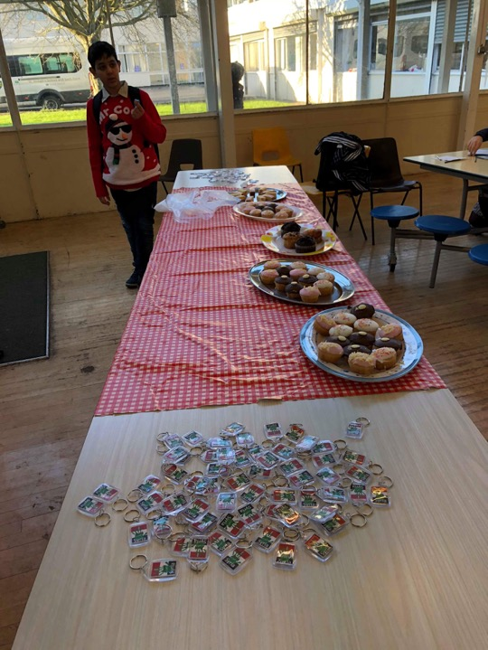
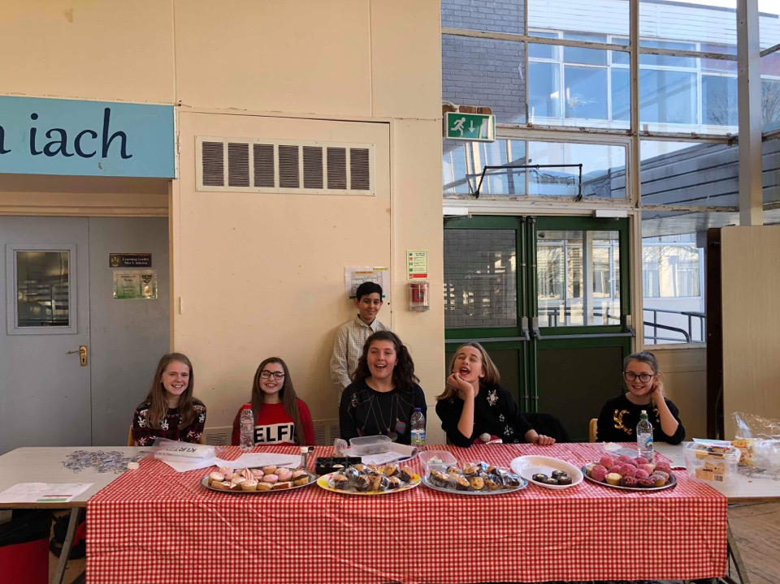
Pupils who give their energies and skills so that others will benefit
Pupils who engage with contemporary issues
Pupils came up with ways to make money and raise awareness for Syrian refugees
They raised £250 altogether.
Pupils who identify and grasp opportunities
Pupils who are ready to be citizens of Wales and the World

Slide 11
We have used the days as vehicles to explore deeper issues associated with them. Selected days where the Geography and History naturally fit in.
Focus on 4 events:
Death of Chico Mendes
9/11 Terrorist Attacks
1607 South Wales Tsunami
Titanic

Slide 12
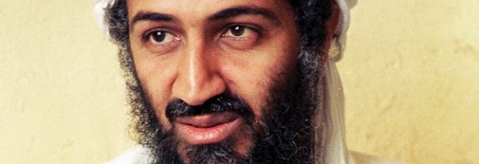
9/11 Attacks
There was initially stereotypical, uninformed views of Muslims
Repeating things that they’ve seen in the media / around them (one pupil in particular)
There was a fundamental need to address these stereotypes FIRST!
Pupils who engage with contemporary issues
Pupils who are ready to be citizens of Wales and the World

Slide 13
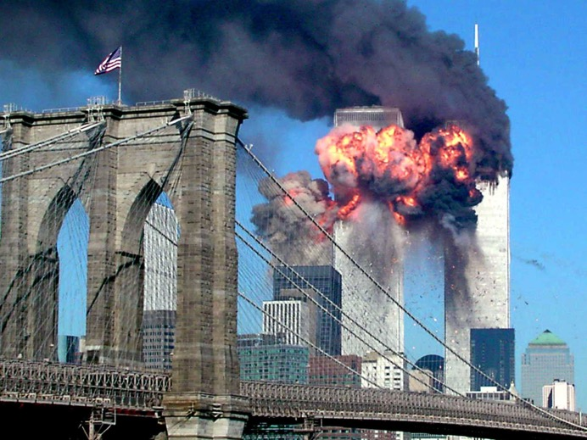
Experience of 1 lesson - Sensory

Slide 14
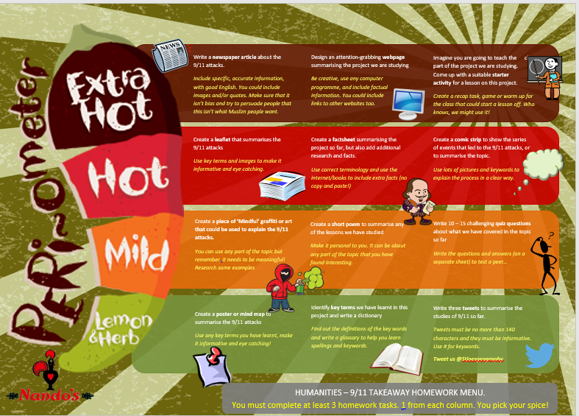
Homework Menu
A new approach with spectacular results!

Slide 15
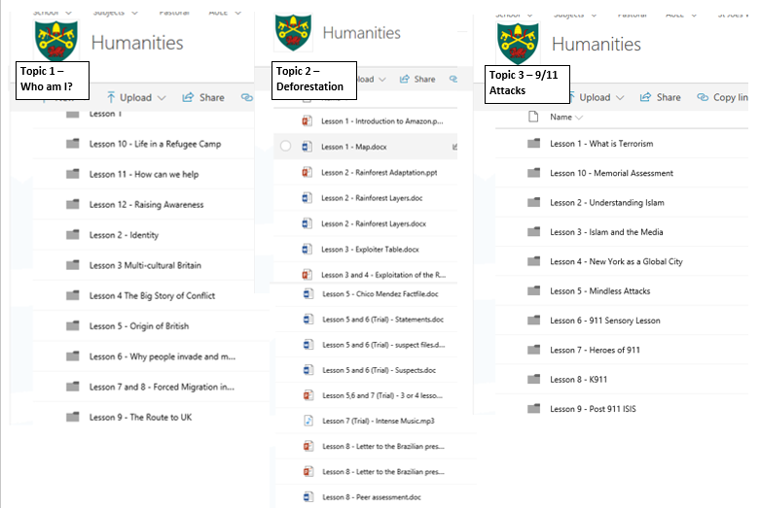

Slide 16
What we’ve found …
You need staff to be on board first and foremost
It needs to be a subject unto itself
You need to have courage
It presents opportunities to teach in a whole new way
Learners love it!

