Slide 1

Student Finance
For Parents and Students
Mr Torrance and Mrs Gow
Notes:
Good afternoon everybody and we hope you are keeping well and taking care of yourselves.
This afternoon you got me (Mr Torrance) and Mrs Gow (say hello) hoping to briefly take you through the Student Finance process for university entry for September 2020. Like I said in the letter I sent to you we are not experts in this process at all and we usually have a representative from a university or student finance to deliver a session but this obviously hasn’t been possible. Another reason for this is that the process is very individual to students, parents and families and their financial situation. The idea of this session is to give you all the information available so that you can try and work out the impact of your own family circumstances on students finance from September.

Slide 2











The cost of studying a degree
HEI’s will be able to charge up to £9,295 for students starting university in 2020 in England and Wales.
Most Welsh university fees are currently £9,000 pa
Notes:
To start with, how much does it all actually cost?
There are three main expenditure for students each year for their university degree:
- Cost of studying a degree
Cost of accommodation
Cost of living
To give you a general idea, the tuition fee (which is the cost of studying a degree) is approx £9k a year – this is paid directly to a university (you never see this).
The average cost of accommodation is Wales (for example at Cardiff Met university in…….. – you have to pay this in installments 3 times a year.
Cost of living is food and drink, transport, and drink, books, and drink clothes, etc etc.

Slide 3

Finance Support - Wales
Tuition Fee Loan
Maintenance Grant
Maintenance Loan
Bursaries & Scholarships
Notes:
There are four different venues of financial support in Wales available to you all. They are a Tuition Fee Loan, Maintenance Grant, Maintenance Loan and Bursaries. We will go into this in more detail now. Just before we start being specific, the main things to note are Loans are what you have to pay back and Grants are what you are given and you never have to pay back. Also with the loans you don’t have to start paying back until you start earning above a certain amount.

Slide 4


Paid Directly to the University
Paid via Student Loans Company
Covers Tuition Fees Only
Max. Loan is £9,250
Tuition Fee Loan
Notes:
First, you are eligible to a TUITION FEE LOAN, it is paid directly to your university by the STUDENT LOAN COMPANY. You never see this money. Everyone should be eligible for the full amount and that isn’t based on any other income. You just get it. It’s a loan so you will have to pay it back eventually.

Slide 5


Maintenance Package
Paid Directly to the you!
Paid in 3 instalments
Based on Household Income
Should be used for living expenses
Notes:
Secondly, is a slightly new system that have been introduced by Student Finance Wales quite recently. This includes a mixture of grants and loans that you will receive 3 times a year (in installments) to pay for accommodation and other living costs. How much you get (grant vs loan) is based on your household income.

Slide 6

Financial Support – Maintenance Package
Welsh Students
Income | Living away from home, outside of London |  |  | Living with parents |  |  | Living away from home, studying in London
 | Grant | Loan | Total | Grant | Loan | Total | Grant | Loan | Total
£18,370 or less | £8,100 | £1,125 | £9,225 | £6,885 | £955 | £7,840 | £10,124 | £1,406 | £11,530
£20,000 | £7,817 | £1,408 |  | £6,651 | £1,189 |  | £9,760 | £1,770
£25,000 | £6,947 | £2,278 |  | £5,930 | £1,910 |  | £8,643 | £2,887
£30,000 | £6,078 | £3,147 |  | £5,209 | £2,631 |  | £7,526 | £4,004
£35,000 | £5,208 | £4,017 |  | £4,488 | £3,352 |  | £6,408 | £5,122
£40,000 | £4,339 | £4,886 |  | £3,767 | £4,073 |  | £5,291 | £6,239
£45,000 | £3,469 | £5,756 |  | £3,047 | £4,793 |  | £4,174 | £7,356
£50,000 | £2,600 | £6,625 |  | £2,326 | £5,514 |  | £3,056 | £8,474
£55,000 | £1,730 | £7,495 |  | £1,605 | £6,235 |  | £1,939 | £9,591
£59,200 or more | £1,000 | £8,225 |  | £1,000 | £6,840 |  | £1,000 | £10,530
Notes:
For most students who will be living away from home but outside on London, you should receive £9,225 a year (split into three installments of approx. £3000) but your current household income (that is the income of your parents) will determine how much of that is a Grant and how much is a loan. This is where you will have your own individual circumstances and you can start to work out how much you are likely to get. This can be used when you are choosing what accommodation to select at your universities. For example, if your household income is £27,000 then you will receive £9,225 a year but £6,947 will be a grant £2,278 will be a loan. The difference will not matter until after you have finished your degree and they start working out how much you have to pay back.
If you are planning to stay at home during your degree you are still eligible for money just less and also if you are attending a university in London the amount is greater, due to the higher cost of living.

Slide 7

Financial Support – Extra Support
Extra money or support may be
available to you if you:
Have a disability, including a long-term (3months+) health condition, mental-health condition or specific learning difficulty
  Disabled Student Allowances (DSA’s) – helps towards the additional costs that you may face as a result of your disability
Have children or adults that depend on you
  Childcare Grant
  Parents’ Learning Allowance
  Adult Dependents Grant
Notes:
Other options too, for a few of our students you find themselves in these different categories – you will b able to apply for these as part of the process.

Slide 8
Financial Support – Extra Support
Extra money or support may be
available to you if you:
Are a Care Leaver
  Aged 25 or under
  If you have been looked after by the care system for at least 13 weeks since the age of 14
Are an Estranged Student
  Studying without a family support network
Support: Dedicated staff mentor / Pre-entry support meeting / Financial support (Care Leavers Bursary) / Year-round accommodation

Slide 9


Student Loan Repayment - 2020
borrowers will repay 9% of their income above the repayment threshold
Earnings | Monthly Salary | Monthly Deductions
<£25,000 | £2,083 | £0.00
£27,000 | £2,250 | £15.00
£30,000 | £2,500 | £37.00
£35,000 | £2,916 | £75.00
£40,000 | £3,333 | £112.00
*Interest Rates range from RPI to RPI + 3%

Slide 10

Application Process – STEP 1
Notes:
Studentfinancewales.co.uk > Login/Register

Slide 11
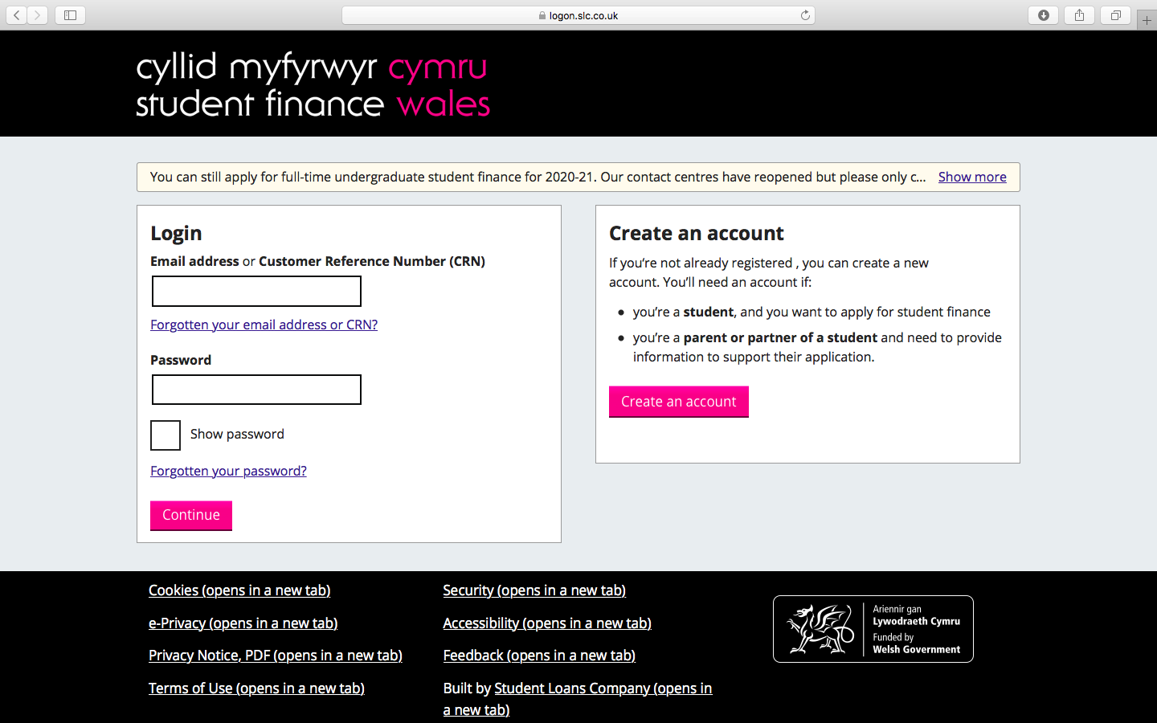
Application Process – STEP 2
Notes:
Some might already have a login for EMA – you can login, if not Create an account

Slide 12
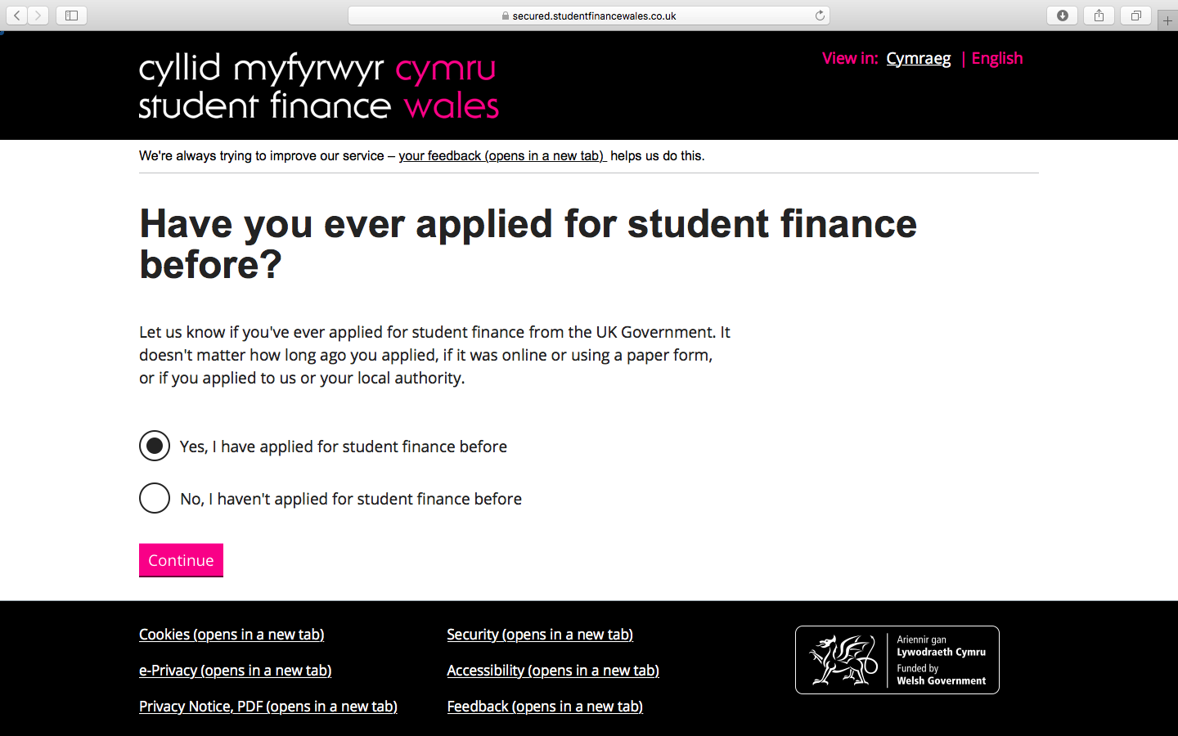
Application Process – STEP 3
Notes:
If you create an account you are asked this question:
If you receive EMA, then the answer is Yes – this means it will try and link you details together. You will need some details from your EMA account/application. If you haven’t got them then you will need to phone Student Finance Wales and ask for it.
Otherwise, click No.
This application process will ask some of your personal details including university choice (don’t worry you can change it), bank account details (again you can change it) but it will also ask you for details of your parents who live with you in your household – they will then receive an email with an link to a separate account where it might ask for evidence of certain things you have said (annual earnings, benefit claims, etc) this could be a payslip, P60, benefit claim, etc.
You will then have a letter in a few weeks with all the amounts detailed.

Slide 13
UCAS Offers

Slide 14
Any queries or questions?

